Slide 1
Math 769: Statistical Learning

Slide 2
Minimum Description Length (MDL)
Shahrzad Jamshidi, PhD

Slide 3
Last Time
We discussed the AIC and BIC metrics for balancing model complexity with fit.
These are best used for model selection and tend to favor lower-variance models.

Slide 4
Objectives
State the aim of MDL
Study the formula for discussing it as a metric
Observe that MDL is equivalent to BIC as a metric

Slide 5
Minimum Description Length
The Minimum Description Length (MDL) principle is a method in information theory for inductive inference
emphasizes the simplicity and compactness of models.
The fundamental idea behind MDL is to select the model that results in the shortest description length of both the model and the data combined.

Slide 6
Foundation for MDL
MDL is grounded in the concepts of information theory, particularly those relating to data compression.
It aligns with Occam's Razor, suggesting that the simplest model that explains the data is often the most plausible.

Slide 7
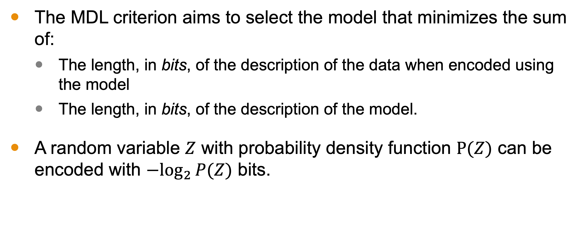
MDL Criterion
The MDL criterion aims to select the model that minimizes the sum of:
The length, in bits, of the description of the data when encoded using the model
The length, in bits, of the description of the model.
A random variable $Z$ with probability density function $P(Z)$ can be encoded with $−\log_{2}⁡P(Z)$ bits.

Slide 8
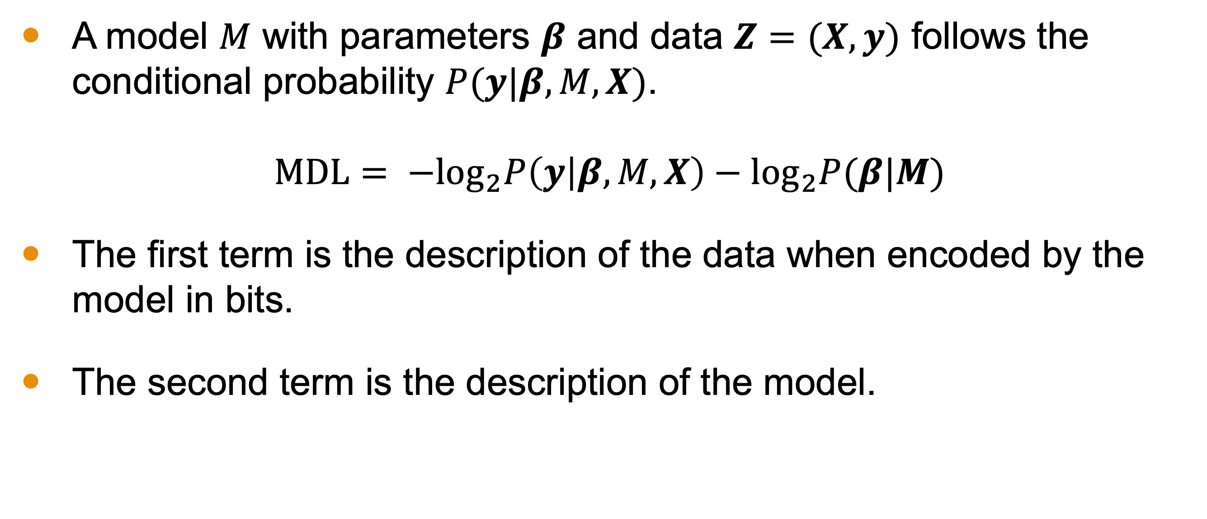
MDL Calculation
A model $M$ with parameters $β$ and data $Z=(X, y)$ follows the conditional probability $P(y|β,M,X)$.
$$MDL= −\log_{2}P\left(y | β,M,X\right)−\log_{2}P(β|M)$$
The first term is the description of the data when encoded by the model in bits.
The second term is the description of the model.

Slide 9
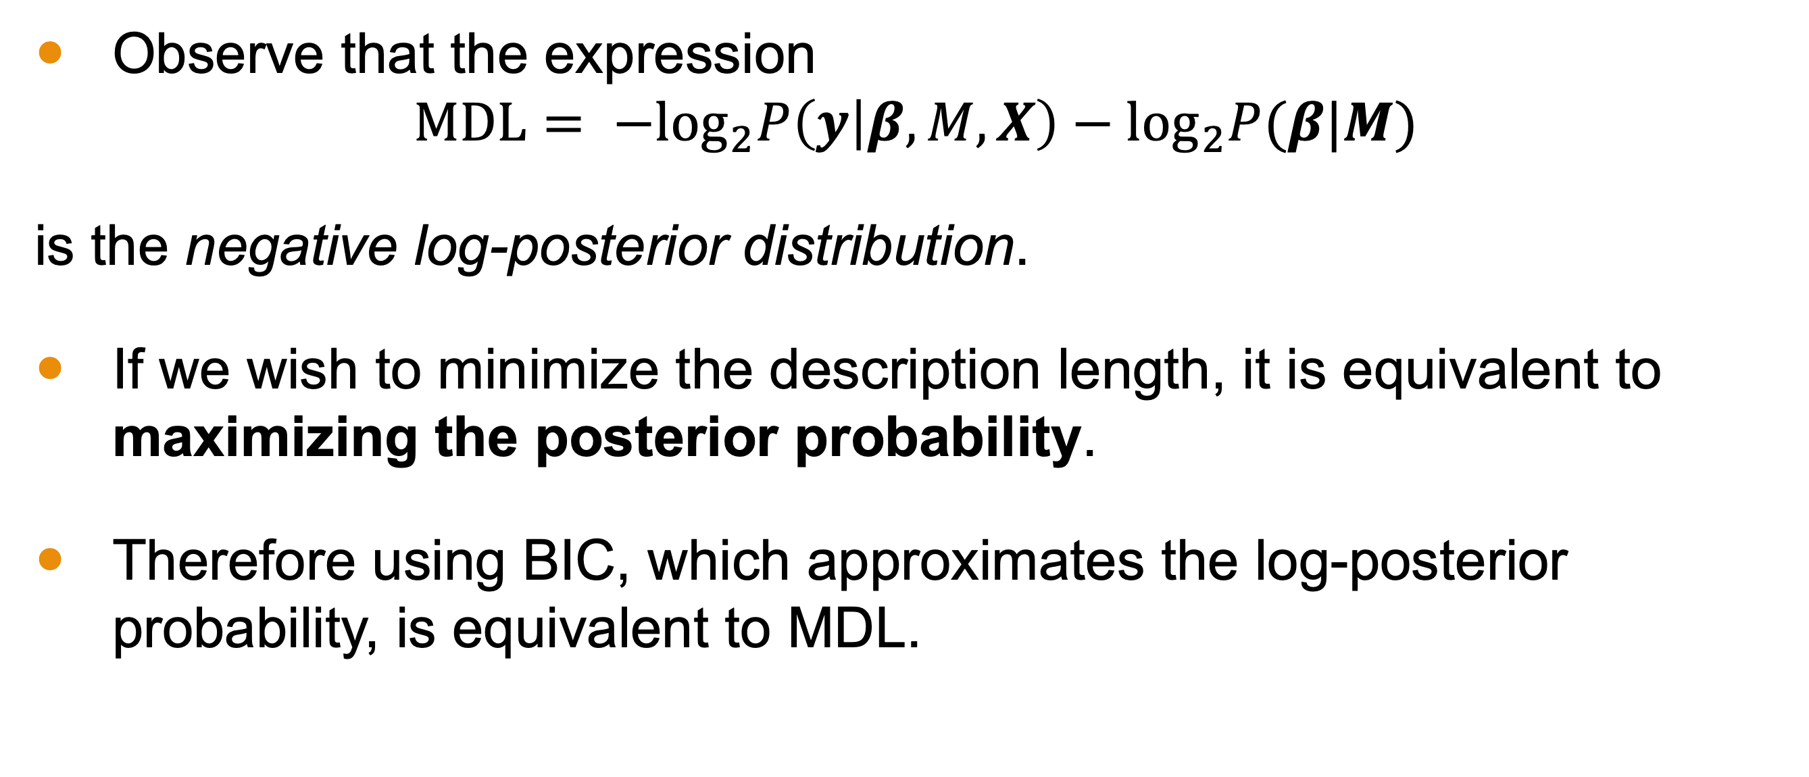
MDL and BIC
Observe that the expression
$$MDL= −\log_{2}P\left(y | β,M,X\right)−\log_{2}P(β|M)$$
is the negative log-posterior distribution.
If we wish to minimize the description length, it is equivalent to maximizing the posterior probability.
Therefore using BIC, which approximates the log-posterior probability, is equivalent to MDL.

Slide 10
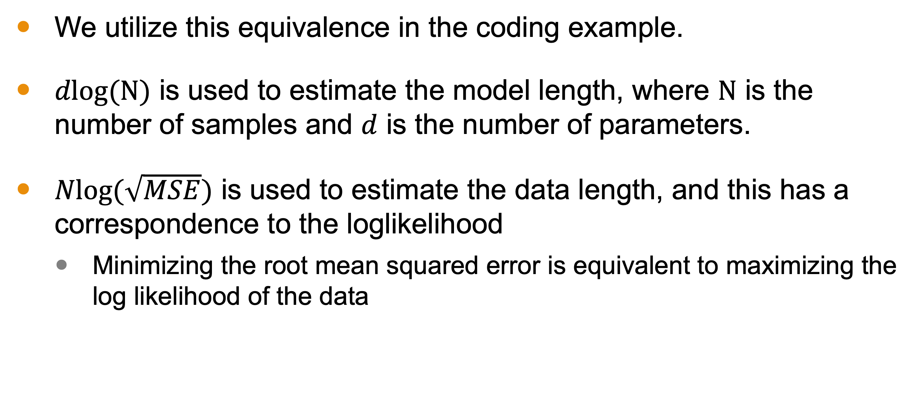
Coding Example
We utilize this equivalence in the coding example.
$dlog(N)$ is used to estimate the model length, where $N$ is the number of samples and $d$ is the number of parameters.
$Nlog(\sqrt{MSE})$ is used to estimate the data length, and this has a correspondence to the loglikelihood
Minimizing the root mean squared error is equivalent to maximizing the log likelihood of the data

Slide 11
Conclusion
MDL is another information theoretic criterion.
It attempts to select a model by minimizing the description length of the data (under the model) and the model.
This is achieved through an equation that has a direct correspondence to BIC
Hence BIC and MDL should be thought of as equivalent approaches from different perspectives.

